Slide 1
Rockbuster stealth
Data ANALYSIS by Dimitrios Athanasoulias

Slide 2

The state of play
Rockbuster stealth LLC is a movie rental company that used to have physical stores around the world.
Following the consumer move to online streaming, the company is planning to use its existing movie licenses to launch an online video rental service in order to stay competitive.
The following analysis aims to provide useful insights and recommendations to help with the launch strategy for the new online video service.

Slide 3
KEY QUESTIONS
Which movies and GENRES contributed the most/least to revenue gain?
What was the average rental duration for all videos?
Do sales figures vary between geographic regions?
Which countries are Rockbuster customers based in?
Where are customers with a high lifetime value based?

Slide 4
Revenue by genre
Total revenue: 61,312.04 USD
The Sports genre accounts for almost 8% of the total revenue with $4,900 in total sales. The genre with the lowest revenue is Thriller.

Slide 5
Movies contributing most/least in revenue
Top 10 |  |  |  |  |  | Bottom 10
Title | Genre | Rating | Revenue |  |  | Title | Genre | Rating | Revenue
Telegraph Voyage | Music | PG | $ 215.75 |  |  | Oklahoma Jumanji | New | PG | $ 5.94
Zorro Ark | Comedy | NC-17 | $ 199.72 |  |  | Duffel Apocalypse | Documentary | G | $ 5.94
Wife Turn | Documentary | NC-17 | $ 198.73 |  |  | Texas Watch | Horror | NC-17 | $ 5.94
Innocent Usual | Foreign | PG-13 | $ 191.74 |  |  | Freedom Cleopatra | Comedy | PG-13 | $ 5.95
Hustler Party | Comedy | NC-17 | $ 190.78 |  |  | Young Language | Documentary | G | $ 6.93
Saturday Lambs | Sports | G | $ 190.74 |  |  | Rebel Airport | Music | G | $ 6.93
Titans Jerk | Sci-Fi | PG | $ 186.73 |  |  | Treatment Jekyll | Drama | PG | $ 6.94
Harry Idaho | Drama | PG-13 | $ 177.73 |  |  | Cruelty Unforgiven | Classics | G | $ 6.94
Torque Bound | Drama | G | $ 169.76 |  |  | Lights Deer | Classics | R | $ 7.93
Dogma Family | Animation | G | $ 168.72 |  |  | Japanese Run | Horror | G | $ 7.94
7 out of the top 10 titles come from the top 5 genres by revenue (highlighted), but only two top 5 films come from these genres (comedy). This could mean that certain titles in Music, Documentary and Foreign genres are very popular and have a high revenue, whereas the top genres contain an overall higher number of popular films.

Slide 6
Overview: Film catalogue and rent Statistics
Films in our catalogue: 1000
Year of every film in catalogue: 2006
Average film length: 115.2 minutes
Average rental duration: 5 days
Average rent: 2.98 USD
There are 1000 films in our catalogue, all released in 2006! The average rental duration is 5 days and is consistent among all genres. The average rent price per film is 2.98 USD.

Slide 7
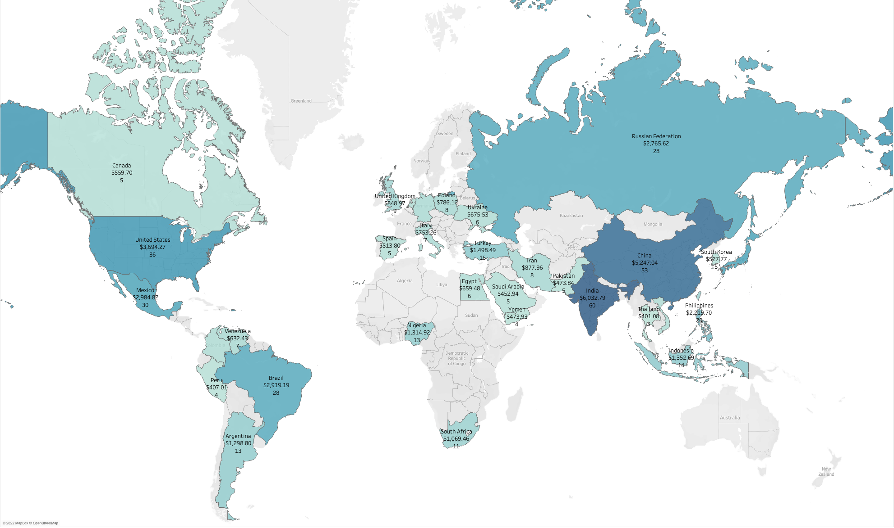
Overview: Countries, CUSTOMERS and REVENUE
Rockbuster stealth has customers in 108 countries. This map shows the top 30% countries in revenue, also including customer numbers.
Top 5 countries: India, China, the US, Japan and Mexico. The top countries in revenue tend to be the same as the ones with the most customers.
Please note: We operate a store in Australia, but we have no customers currently there!

Slide 8
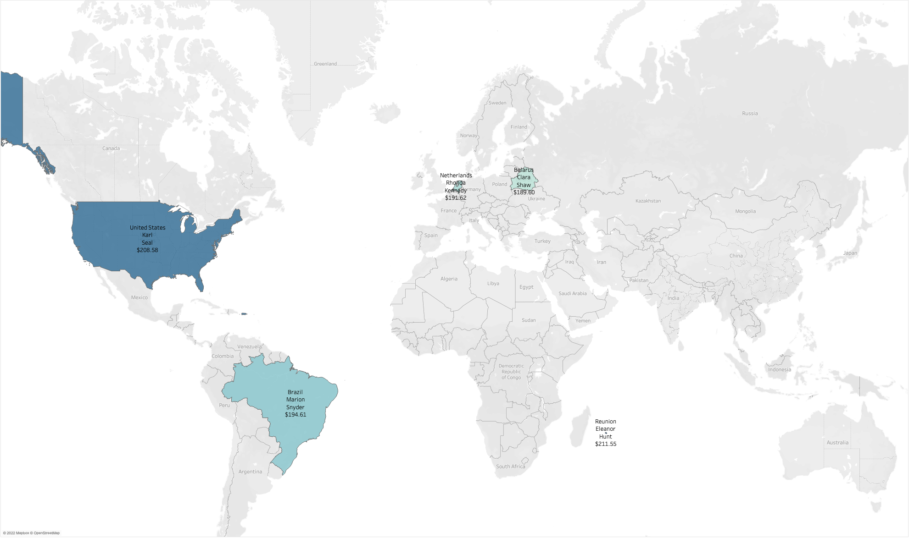
Profile: Top 5 Customers
Our top customers by total spent are located all over the world. Some of them are in countries not featured on the top 10 for revenue. The top customer, Eleanor Hunt, lives on the island of Reunion.

Slide 9
Recommendations and Next Steps
Recommendations
Rockbuster stealth should close the last two remaining physical stores and focus on online movie renting.
Rockbuster stealth should launch its online renting service starting in countries with a large, established customer base that generate substantial revenue: India, China, the U.S., Japan and Mexico.
Rockbuster stealth should expand its film library with movies from different years, and initially focus on the most popular genres: Sports, Sci-Fi, Animation, Drama and Comedy.
Rockbuster stealth should launch a loyalty programme to reward the highest spending and recurring customers. The aim is to maintain our customer base and attract additional customers.
Next Steps
Rockbuster stealth should conduct further analysis to understand why some countries generate very low revenue. Possible reasons: low income, no brand recognition, current affairs, not appealing film catalogue etc.
Rockbuster stealth should conduct further research to explore different pricing structures and the effect they have on customer behaviour and revenue.

Slide 10
Rockbuster stealth
Thank you
Dimitrios Athanasoulias
email@gmail.com

Slide 11
Rockbuster stealth
Questions?
Dimitrios Athanasoulias
email@gmail.com
Tableau Public

